Slide 1
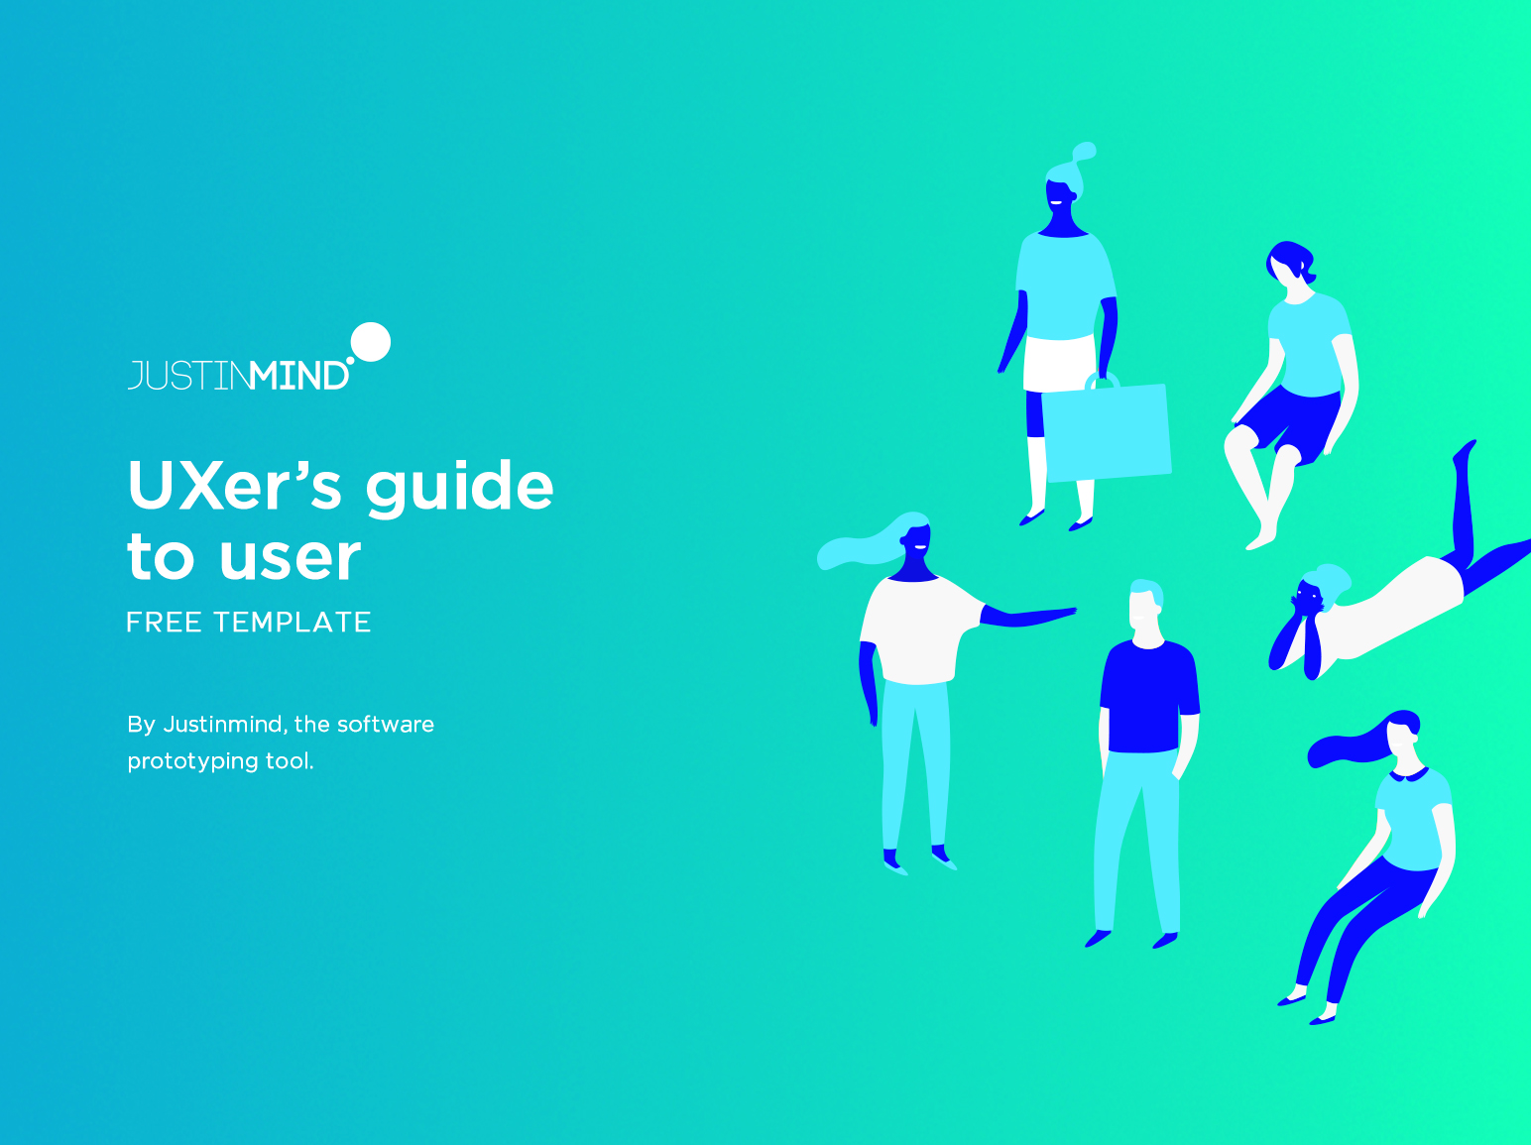

Slide 2
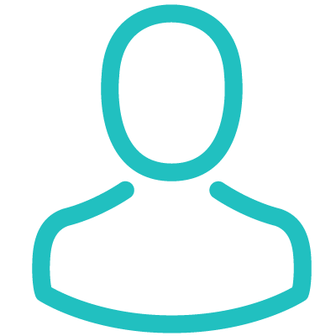
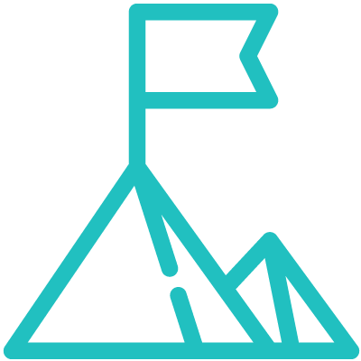
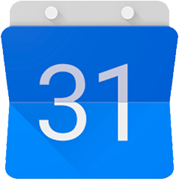
PERSONALITY
BIO
“I want to help my team deliver great user experiences”
Prototyping
Interviewing
Design Thinking
Empathy
Coding
Charlotte recently started a new job as a UX design in a mid-size bank. She moved over from the start-up world and is still getting used to all the changes, particularly the paperwork. She’s excited to bring a user-focused perspective to the design department but nervous because she’s the bank’s first UXer.
Outside of the office she’s a sports-mad psychology grad. She enjoys reading UX blogs and will sometimes go to UX-related conferences if they’re nearby. She’s also tuned into design channels like Dribbble.
“
“
Behavior
Overseeing builds
Writing specs
Designing features
Motivations
Meetings
IMPACT
PROMOTION
User testing
TEAMWORK
USER NEEDS
Influences
Goals
Frustrations
· CREDIBILITY
· COLLEAGUES
· TECHNOLOGY
· BLOGS/ FORUMS
· PSYCHOLOGY
· UI TRENDS
Introduce user focused mentality and methods into traditional company landscape
Improve usability of bank’s customer facing interfaces
Grow the UX team
Getting buy-in for the new department’s activities
Dealing with more bureaucracy than in her old job
Communicating necessity for change to development team
CHARLOTTE WALKER
27, Los Angeles
Frequently used apps
UX DESIGNER
^{· STATUS}
^{SINGLE}
^{· TIER}
^{MID-LEVEL}
^{· SALARY}
^{$50K}
^{· ARCHETYPE}
^{PERFECTIONIST}
Justinmind
Google Calendar
PocketGuard

Slide 3
